Slide 1
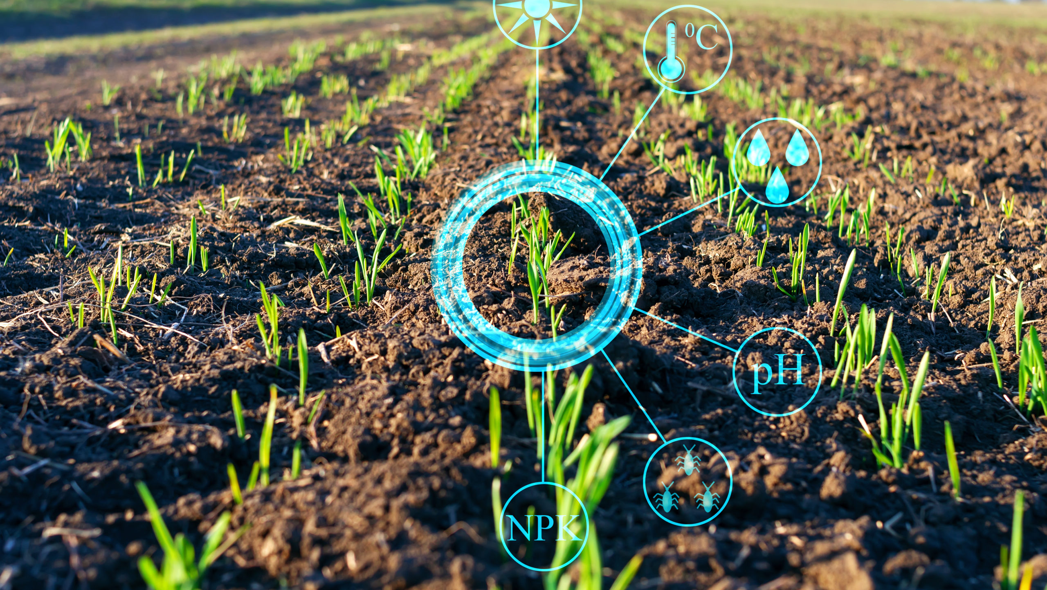
Crop Recommendation
A Machine Learning-based System for Precision Agriculture
Submitted By: Ankita Anil Gondkar

Slide 2

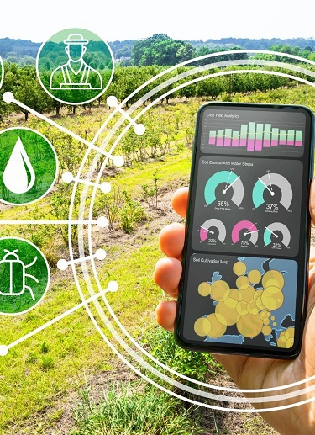
What is Precision Agriculture?
Precision agriculture is a data-driven approach to farming that leverages technology to optimize crop production and resource use
It involves collecting and analyzing various data, such as soil properties, weather conditions, and crop yield records, to make informed decisions and apply site-specific management practices

Slide 3

Objectives
Develop a crop recommendation system that provides accurate and personalized crop suggestions for precision agriculture
Develop an accurate and robust crop recommendation model that factors in multiple data streams for optimal results.
Enhance agricultural productivity by guiding farmers in making data-driven crop selection decisions.

Slide 4
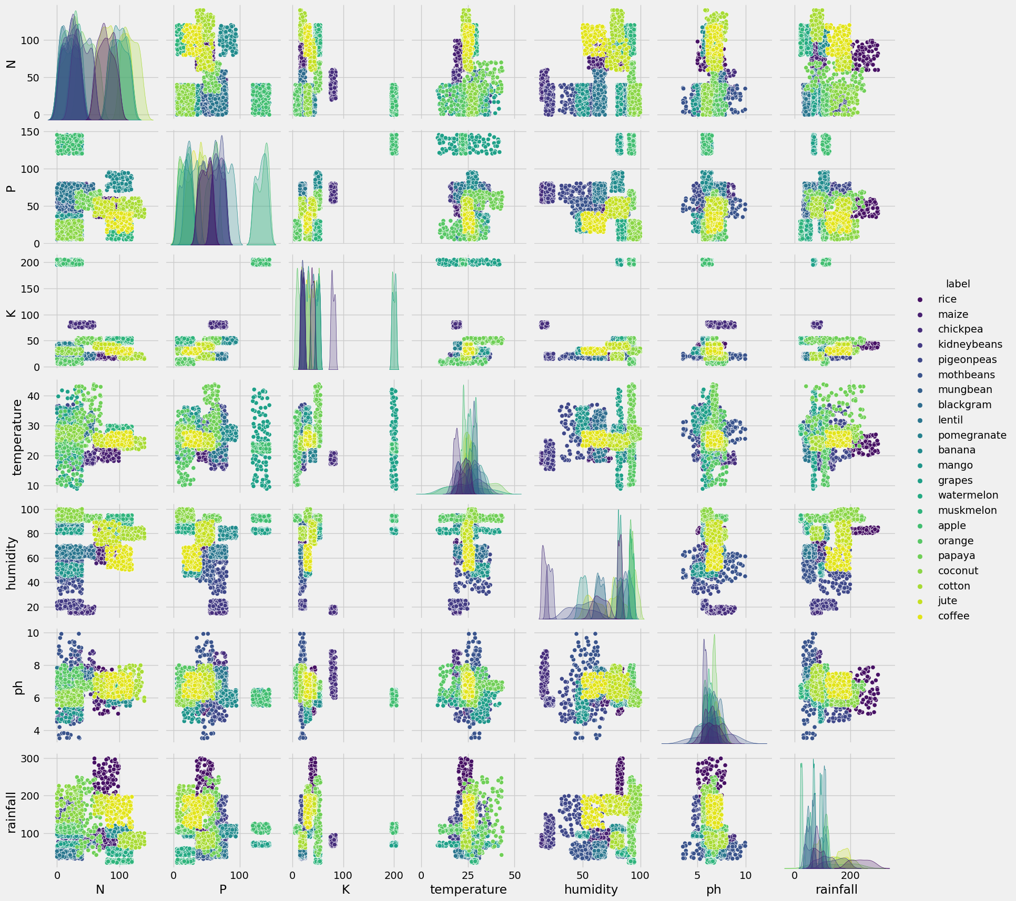
Data Exploration
Explore dataset from Kaggle
This dataset was created by combining datasets of rainfall, climate, and fertilizer data available for India.
The collected data includes soil attributes
pH
Moisture
Nutrient Levels –Nitrogen, Phosphorous, Potassium
climate data
Temperature
Rainfall
Humidity

Slide 5
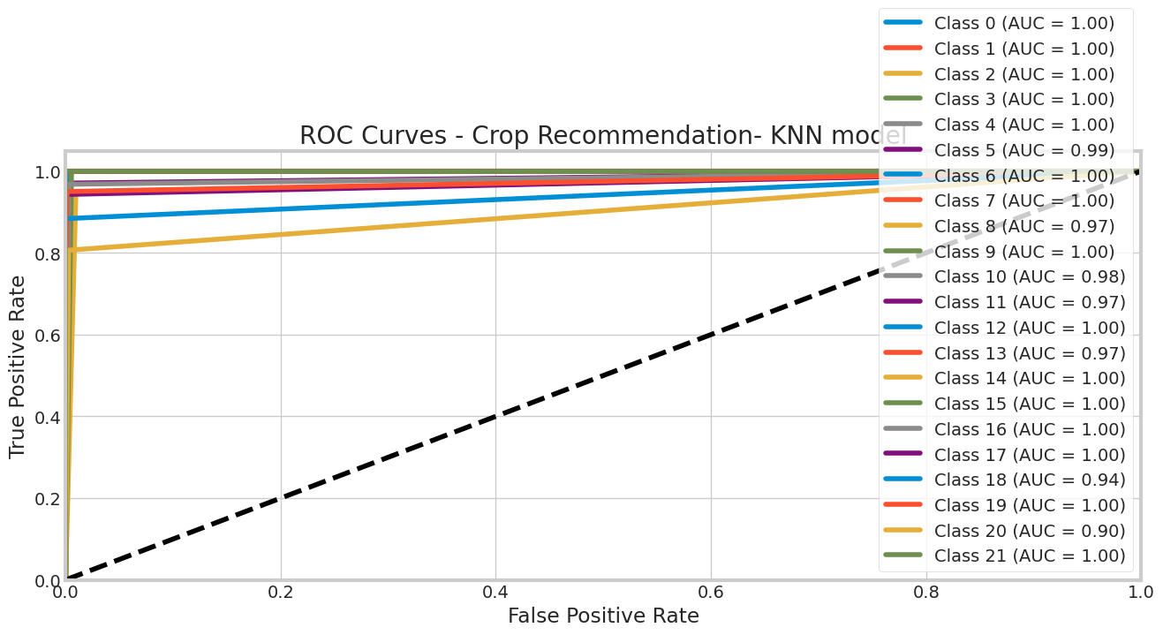
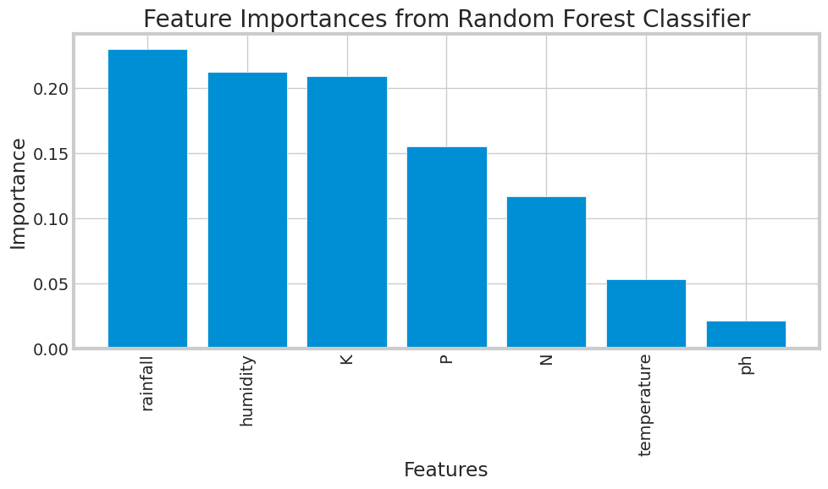
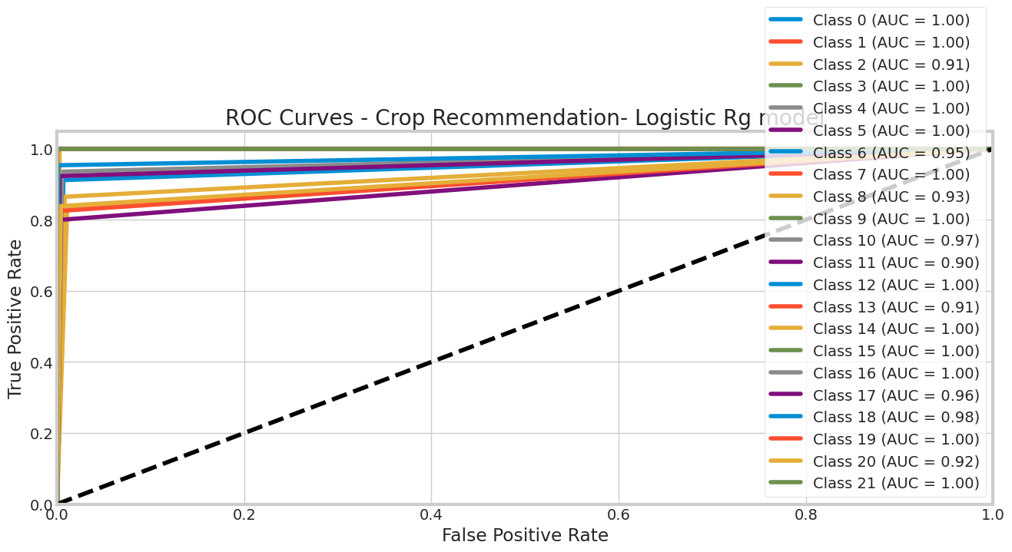
Models
Model | Accuracy (Training) | Accuracy (Testing) | Precision | Recall
Decision Tree | 0.9312 | 0.9121 | 0.9387 | 0.9152
KNN | 0.9888 | 0.9753 | 0.9770 | 0.9758
Logistic Regression | 0.9734 | 0.9494 | 0.9484 | 0.9494
Random Forest | 0.9392 | 0.9143 | 0.9426 | 0.9232

Slide 6
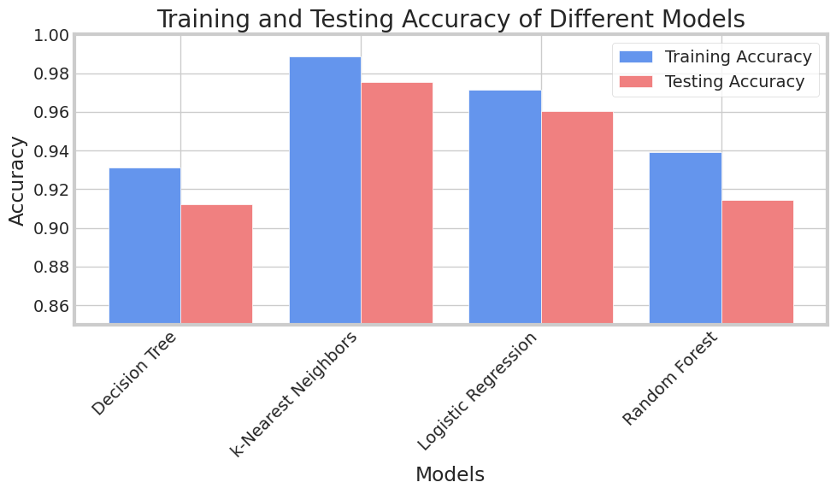
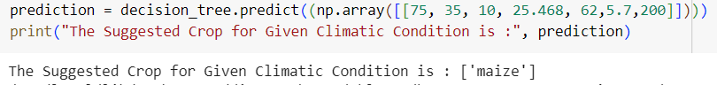
Results
The KNN model has the best overall performance, with the highest accuracy and precision.
The decision tree model has the lowest overall performance, with the lowest accuracy and precision.
The logistic regression model and the random forest model have similar performance, with the logistic regression model having a slightly higher accuracy and the random forest model having a slightly higher precision.
The accuracy of the models on the testing data is lower than the accuracy on the training data. This is because the models are trained on a subset of the data, and they may not generalize well to the entire dataset.
The precision and recall of the models are both high, which means that the models are good at both predicting positive instances correctly and detecting all of the actual positive instances.

Slide 7

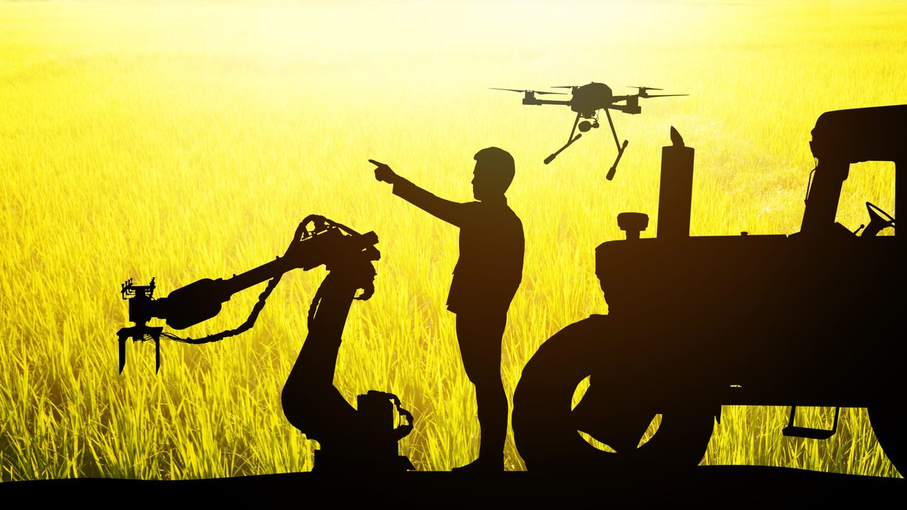



The Future
A valuable tool for modern farmers, enabling data-driven decisions for crop selection in precision agriculture.
The integration of machine learning algorithms, data exploration, and visualization has enabled the system to make informed decisions based on diverse data sources.
Easy to use and accurate, helps farmers improve productivity and sustainability.
Future improvements of the system include incorporating real-time weather data and considering crop market prices.

Slide 8
References
https://www.kaggle.com/
Precision Agriculture Meaning Pros and Cons
Crop Prediction Analysis
Precision Planting
Notebook code

Slide 9


